Slide 1
Concurrency Control
11/12/97
M-<number>

Slide 2
Outline
Lock-Based Protocols
Timestamp-Based Protocols
Validation-Based Protocols
Multiple Granularity
Multiversion Schemes
Insert and Delete Operations
Concurrency in Index Structures

Slide 3
DBMS Concurrency Control
Concurrency Control is the management procedure that is required for controlling concurrent execution of the operations that take place on a database.
Concurrent Execution in DBMS
  In a multi-user system, multiple users can access and use the same database at one time, which is known as the concurrent execution of the database.
  It means that the same database is executed simultaneously on a multi-user system by different user
  While working on the database transactions, there occurs the requirement of using the database by multiple users for performing different operations, and in that case, concurrent execution of the database is performed.
  The thing is that the simultaneous execution that is performed should be done in an interleaved manner,
  no operation should affect the other executing operations, thus maintaining the consistency of the database.
  on making the concurrent execution of the transaction operations, there occur several challenging problems that need to be solved.
M-<number>

Slide 4
DBMS Concurrency Control
Problems with Concurrent Execution
  In a database transaction, the two main operations are READ and WRITE operations. there is a need to manage these two operations in the concurrent execution of the transactions as if these operations are not performed in an interleaved manner,
  the data may become inconsistent.
  the following problems occur with the Concurrent Execution of the operations:
    Problem 1: Lost Update Problems (W - W Conflict)
    Problem 2: Temporary update problem (Dirty Read Problems W-R Conflict)
    Problem 3: Inconsistency problem (Unrepeatable Read Problem W-R Conflict)
M-<number>

Slide 5
DBMS Concurrency Control
Problem 1: Lost Update Problems (W - W Conflict)
  The problem occurs when two different database transactions perform the read/write operations on the same database items in an interleaved manner (i.e., concurrent execution) that makes the values of the items incorrect hence making the database inconsistent.
  occurs due to the update of the same record by two different transactions at the same time.
M-<number>

Slide 6
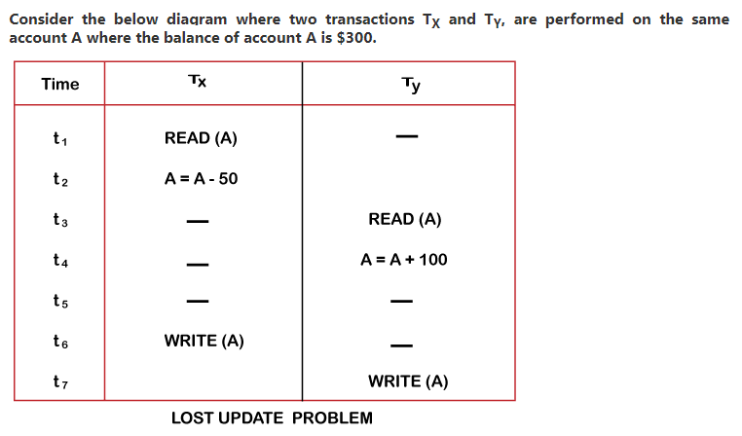
DBMS Concurrency Control
Problem 1: Lost Update Problems (W - W Conflict)
Example
M-<number>

Slide 7
DBMS Concurrency Control
Problem 1: Lost Update Problems (W - W Conflict)
Example
  At time t1, transaction T_{X} reads the value of account A, i.e., $300 (only read).
  At time t2, transaction T_{X} deducts $50 from account A that becomes $250 (only deducted and not updated/write).
  Alternately, at time t3, transaction T_{Y} reads the value of account A that will be $300 only because T_{X} didn't update the value yet.
  At time t4, transaction T_{Y} adds $100 to account A that becomes $400 (only added but not updated/write).
  At time t6, transaction T_{X} writes the value of account A that will be updated as $250 only, as T_{Y} didn't update the value yet.
  Similarly, at time t7, transaction T_{Y} writes the values of account A, so it will write as done at time t4 that will be $400. It means the value written by T_{X} is lost, i.e., $250 is lost.
  Hence data becomes incorrect, and database sets to inconsistent.
M-<number>

Slide 8
DBMS Concurrency Control
    Problem 2: Temporary Update Problem (Dirty Read Problems W-R Conflict)
  The dirty read problem occurs when one transaction updates an item of the database, and somehow the transaction fails, and before the data gets rollback, the updated database item is accessed by another transaction. There comes the Read-Write Conflict between both transactions
M-<number>

Slide 9
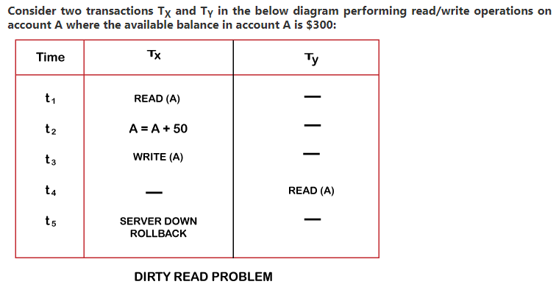
DBMS Concurrency Control
    Problem 2: Temporary Update Problem (Dirty Read Problems W-R Conflict)
Example
M-<number>

Slide 10
DBMS Concurrency Control
    Problem 2: Temporary Update Problem (Dirty Read Problems W-R Conflict)
Example
  At time t1, transaction T_{X} reads the value of account A, i.e., $300.
  At time t2, transaction T_{X} adds $50 to account A that becomes $350.
  At time t3, transaction T_{X} writes the updated value in account A, i.e., $350.
  Then at time t4, transaction T_{Y} reads account A that will be read as $350.
  Then at time t5, transaction T_{X} rollbacks due to server problem, and the value changes back to $300 (as initially).
  But the value for account A remains $350 for transaction T_{Y} as committed, which is the dirty read and therefore known as the Dirty Read Problem
M-<number>

Slide 11
DBMS Concurrency Control
    Problem 3: Inconsistency problem (Unrepeatable Read Problem W-R Conflict)
  Also known as Inconsistent Retrievals Problem that occurs when in a transaction, two different values are read for the same database item.
M-<number>

Slide 12
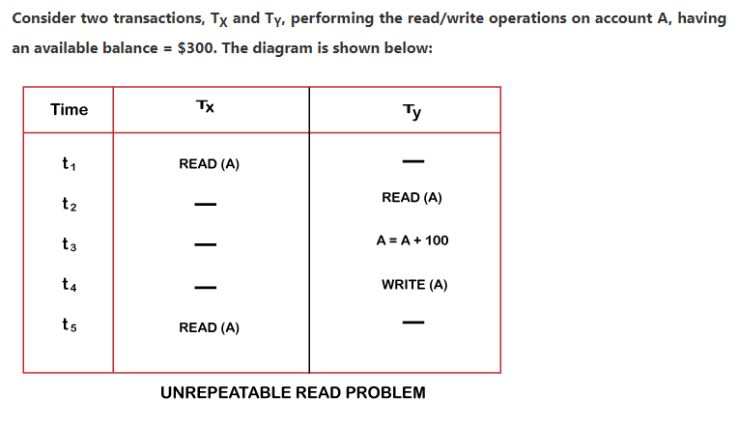
DBMS Concurrency Control
    Problem 3: Inconsistency problem (Unrepeatable Read Problem W-R Conflict)
    Example
M-<number>

Slide 13
DBMS Concurrency Control
    Problem 3: Inconsistency problem (Unrepeatable Read Problem W-R Conflict) Example
      At time t1, transaction T_{X} reads the value from account A, i.e., $300.
      At time t2, transaction T_{Y} reads the value from account A, i.e., $300.
      At time t3, transaction T_{Y} updates the value of account A by adding $100 to the available balance, and then it becomes $400.
      At time t4, transaction T_{Y} writes the updated value, i.e., $400.
      After that, at time t5, transaction T_{X} reads the available value of account A, and that will be read as $400.
      It means that within the same transaction T_{X}, it reads two different values of account A, i.e., $ 300 initially, and after updation made by transaction T_{Y}, it reads $400. It is an unrepeatable read and is therefore known as the Unrepeatable read problem.
    Thus, in order to maintain consistency in the database and avoid such problems that take place in concurrent execution, management is needed, and that is where the concept of Concurrency Control comes into role.
M-<number>

Slide 14
Concurrency Control
Concurrency Control
  is the working concept that is required for controlling and managing the concurrent execution of database operations and thus avoiding the inconsistencies in the database.
  for maintaining the concurrency of the database, we have the concurrency control protocols
Concurrency Control Protocols
  The concurrency control protocols ensure the atomicity, consistency, isolation, durability and serializability of the concurrent execution of the database transactions.
  Therefore, these protocols are categorized as:
    Lock Based Concurrency Control Protocol
    Time Stamp Concurrency Control Protocol
    Validation Based Concurrency Control Protocol
M-<number>

Slide 15
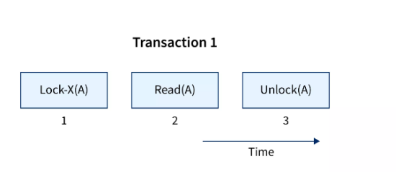
Concurrency Control
Lock Based Concurrency Control Protocol
  We can define a lock-based protocol in DBMS as a mechanism that is responsible for preventing a transaction from reading or writing data until the necessary lock is obtained.
  The concurrency problem can be solved by securing or locking a transaction to a specific user.
  The lock is a variable that specifies which activities are allowed on a certain data item
M-<number>

Slide 16
Concurrency Control
Types of Locks in DBMS
  there are two modes for locking and unlocking data items Shared Lock (lock-S) and Exclusive Lock (lock-X).
M-<number>

Slide 17
Concurrency Control
Types of Locks in DBMS
  there are two modes for locking and unlocking data items Shared Lock (lock-S) and Exclusive Lock (lock-X).
M-<number>

Slide 18
Concurrency Control
Shared Locks
  denoted as lock-S(),
  defined as locks that provide Read-Only access to the information associated with them.
  a shared lock is used on a database, it can be read by several users, but these users who are reading the information or the data items will not have permission to edit it or make any changes to the data items.
  multiple shared locks can be installed on them at the same time, but the data item must not have any other locks connected with it.
  a shared lock, also known as a read lock, is solely used to read data objects.
  read integrity is supported via shared locks.
  shared locks can also be used to prevent records from being updated.
  S-lock is requested via the Lock-S instruction.
M-<number>

Slide 19
Concurrency Control
Exclusive Lock
  allows the data item to be read as well as written.
  this is a one-time use mode that can't be utilized on the exact data item twice.
  to obtain X-lock, the user needs to make use of the lock-x instruction.
  after finishing the 'write' step, transactions can unlock the data item.
  by imposing an X lock on a transaction that needs to update a person's account balance, for example, you can allow it to proceed. As a result of the exclusive lock, the second transaction is unable to read or write
  the other name for an exclusive lock is write lock.
  at any given time, the exclusive locks can only be owned by one transaction
M-<number>

Slide 20
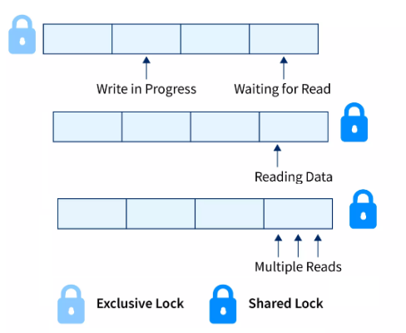
Concurrency Control
Shared Locks
M-<number>

Slide 21
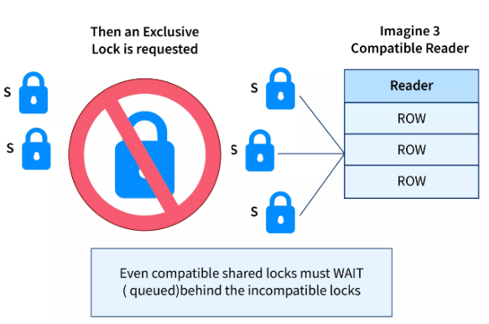
Concurrency Control
Exclusive Lock
M-<number>

Slide 22
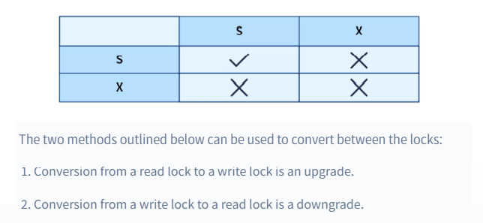
Concurrency Control
Lock Compatibility Matrix
  when using Lock-based protocols in Database Management System is that a Shared Lock can be held by any amount of transactions.
  Exclusive Lock can only be held by one transaction in DBMS, this is because a shared lock only reads data but does not perform any other activities,
  whereas an exclusive lock performs read as well as writing activities.
M-<number>

Slide 23
Concurrency Control
Types of Lock-Based Protocols
  There are four types of lock protocols available:
    Simplistic lock protocol
    Pre-claiming Lock Protocol
    Two-phase locking (2PL)
    Strict Two-phase locking (Strict-2PL)
M-<number>

Slide 24
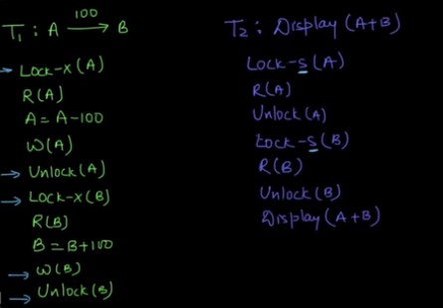
Concurrency Control
Simplistic lock protocol
  allow all the transactions to get the lock on the data before insert or delete or update on it
  unlock the data item after completing the transaction.
M-<number>

Slide 25
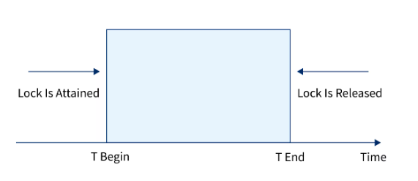
Concurrency Control
Pre-Claiming Lock Protocol
  Pre-claiming protocols evaluate their operations and create a list of data items on which they need locks
  Before initiating an execution, the transaction requests the system for all the locks it needs before hand
  If all the locks are granted, the transaction executes and releases all the locks when all its operations are over.
  If all the locks are not granted, the transaction rolls back and waits until all the locks are granted
  Whenever the transaction is finished, the lock is released.
M-<number>

Slide 26
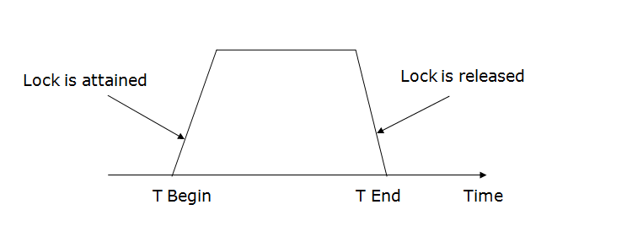
Concurrency Control
Two-phase locking (2PL)
  The two-phase locking protocol divides the execution phase of the transaction into three parts.
  In the first part, when the execution of the transaction starts, it seeks permission for the lock it requires.
  In the second part, the transaction acquires all the locks. The third phase is started as soon as the transaction releases its first lock.
  In the third phase, the transaction cannot demand any new locks. It only releases the acquired locks.
M-<number>

Slide 27
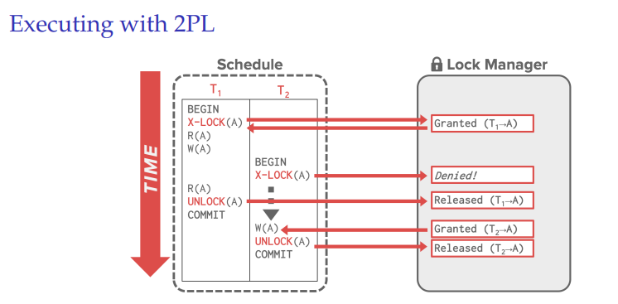
Concurrency Control
Two-phase locking (2PL)
M-<number>

Slide 28
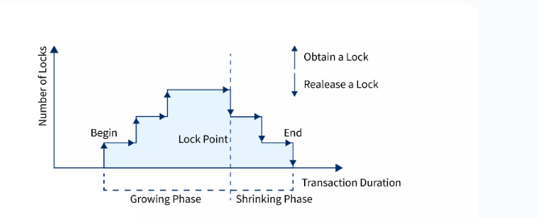
Concurrency Control
Two-phase locking (2PL)
There are two phases of 2PL:
  Growing phase: In the growing phase, a new lock on the data item may be acquired by the transaction, but none can be released.
  Shrinking phase: In the shrinking phase, existing lock held by the transaction may be released, but no new locks can be acquired.
M-<number>

Slide 29
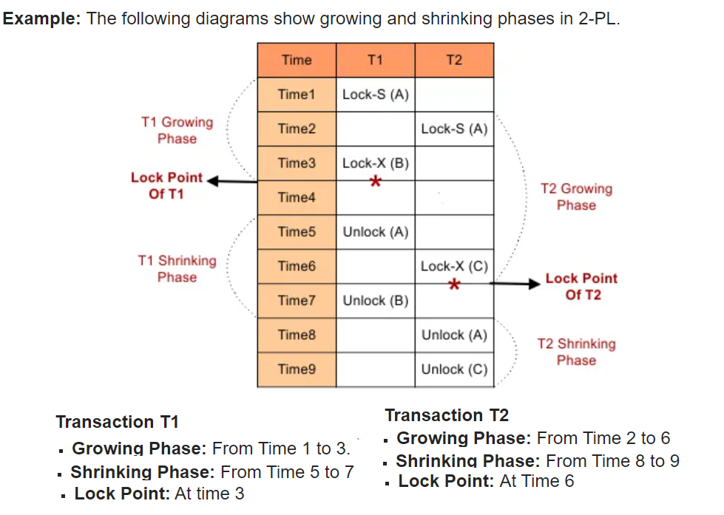
Concurrency Control
M-<number>

Slide 30
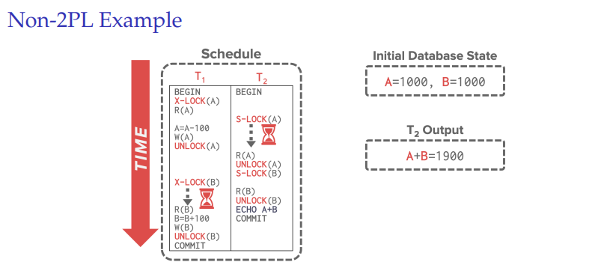
Concurrency Control
M-<number>

Slide 31
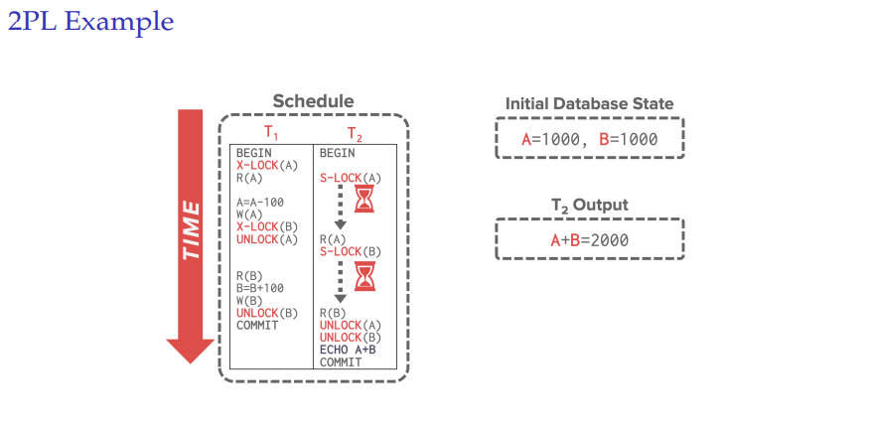
Concurrency Control
.
M-<number>

Slide 32
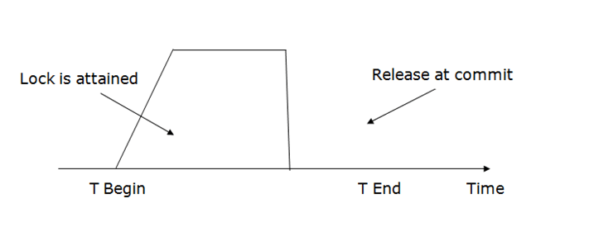
Concurrency Control
Strict Two-phase locking (Strict-2PL)
  The first phase of Strict-2PL is similar to 2PL. In the first phase, after acquiring all the locks, the transaction continues to execute normally.
  The only difference between 2PL and strict 2PL is that Strict-2PL does not release a lock after using it.
  Strict-2PL waits until the whole transaction to commit, and then it releases all the locks at a time.
  Strict-2PL protocol does not have shrinking phase of lock release.
M-<number>

Slide 33
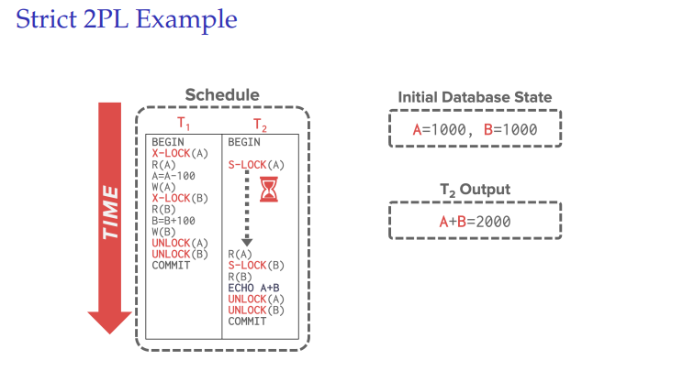
Concurrency Control
M-<number>

